Slide 1
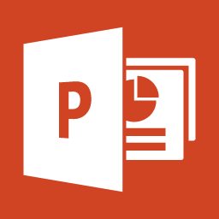
What is Microsoft PowerPoint?
What can do for you?

Slide 2
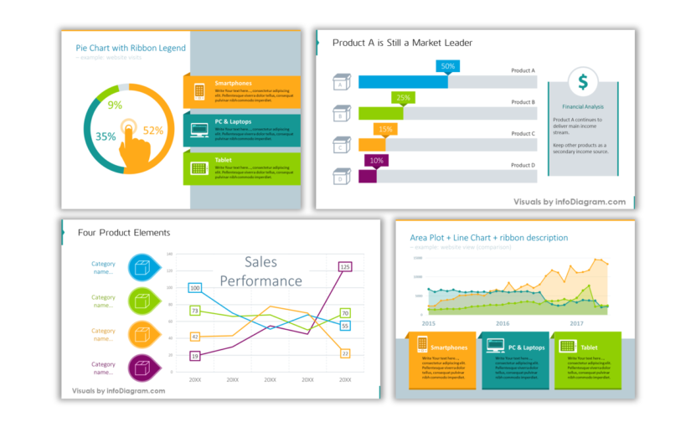
MS PowerPoint (PPT) is a powerful, and easy-to-use application
that allows you to create professional-looking slide shows
Using: pictures,
diagrams,
videos,
and other audio-
visual elements

Slide 3
The application was released for the first time under Microsoft back in 1990
1990

Slide 4
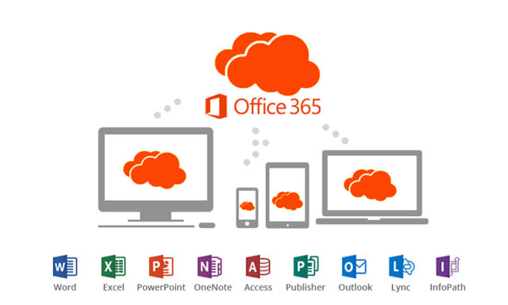
The most recent PowerPoint version was released under Microsoft 365
It is available for Windows, Mac and Mobile devices

