Slide 1
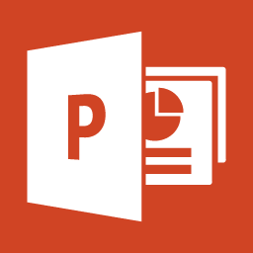
What is Microsoft PowerPoint?
What can do for you?

Slide 2
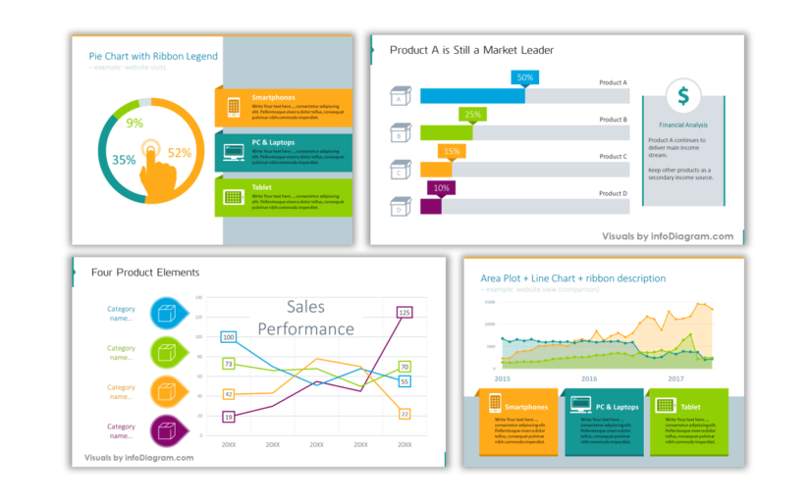
MS PowerPoint (PPT) is a powerful, and easy-to-use application that allows you to create professional-looking slide shows

Slide 3
using pictures, diagrams, videos, and other audio-visual elements

Slide 4
The application was released for the first time under Microsoft back in 1990
1990

Slide 5
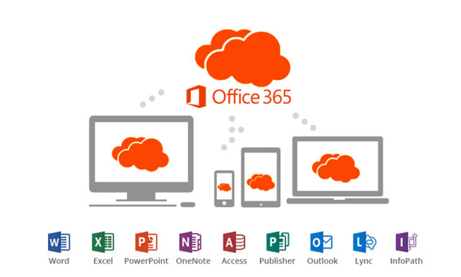
The most recent PowerPoint version was released under Microsoft 365
It is available for Windows, Mac and Mobile devices

