Slide 1
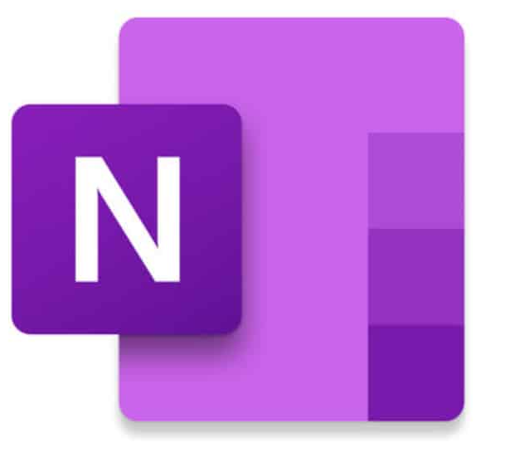
Introduction to Microsoft One note

Slide 2
Agenda
Why One Notes…
What is One Note?
What is the most recent version?

Slide 3

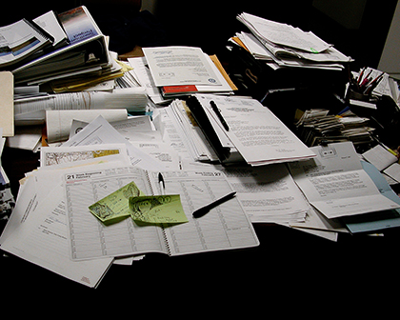
Do you know there is a better way of organizing your notes than this?

Slide 4
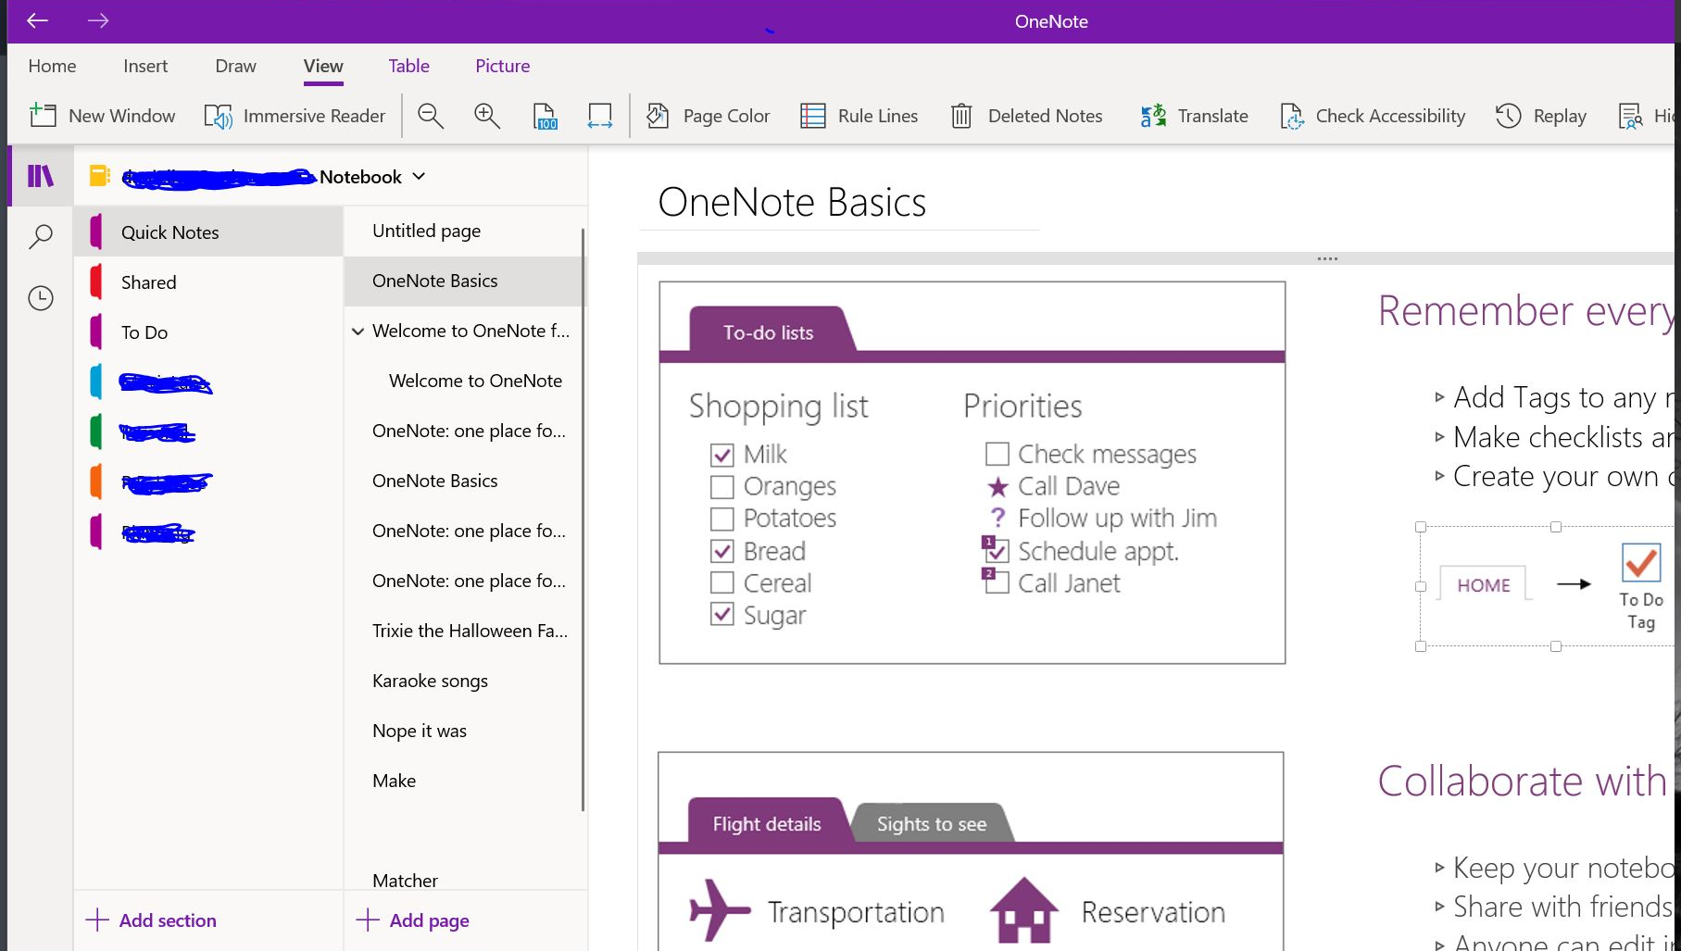
Why One Notes…
One Note is your all-in-one place notes keeper
Stay organize
All your notes saved and easy to find

Slide 5





MS One Note is a powerful, and easy-to-use application that allows you to create personal notes using text, pictures, audio and video elements

Slide 6
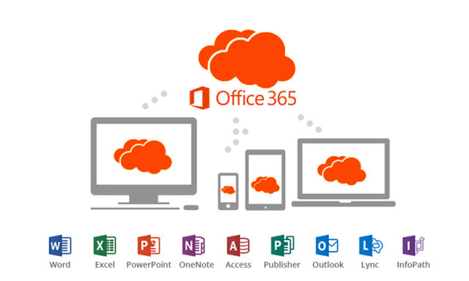
The most recent One Note version was released under Microsoft 365
It is available for Windows, Mac and Mobile devices

